Slide 1
Napkin Pitch: Redesigning the Hospital Waiting Room
A Design Thinking Case Study

Slide 2
Problem Statement
Hospital waiting rooms often cause stress and discomfort due to long wait times, lack of communication, and unwelcoming environments. These factors increase anxiety for patients and families.

Slide 3
Napkin Pitch
We’re redesigning the hospital waiting room experience to be more comfortable and reassuring. Our solution focuses on:
- Improving communication with real-time updates on wait times.
- Ensuring physical comfort with ergonomic seating and calming environments.
- Offering digital distractions to reduce anxiety.
Patients and families will feel more at ease, resulting in a more positive healthcare experience.

Slide 4
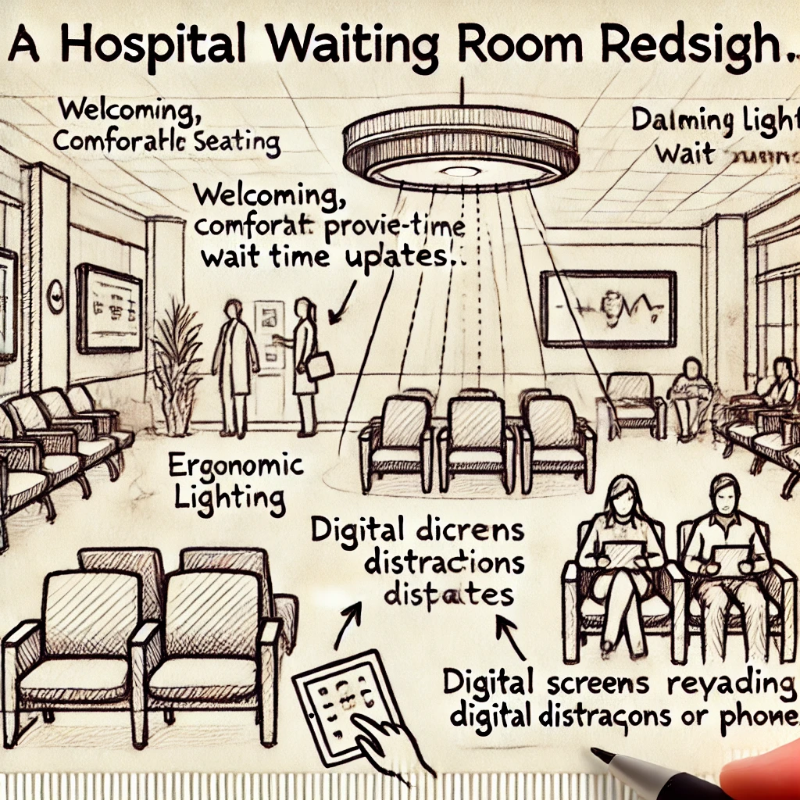
Redesign Sketch

